Slide 1
3. What are Test Environment Management Functions
2. Why is Test Environment Management Important
6
1. What is Test Environment Management?
6. Challenges in Test Environment Management?
5
5. Benefits of Test Environment Management
4. Activities Under TEM Functions
4
Test Environment Mgmt
3
2
1

Slide 2
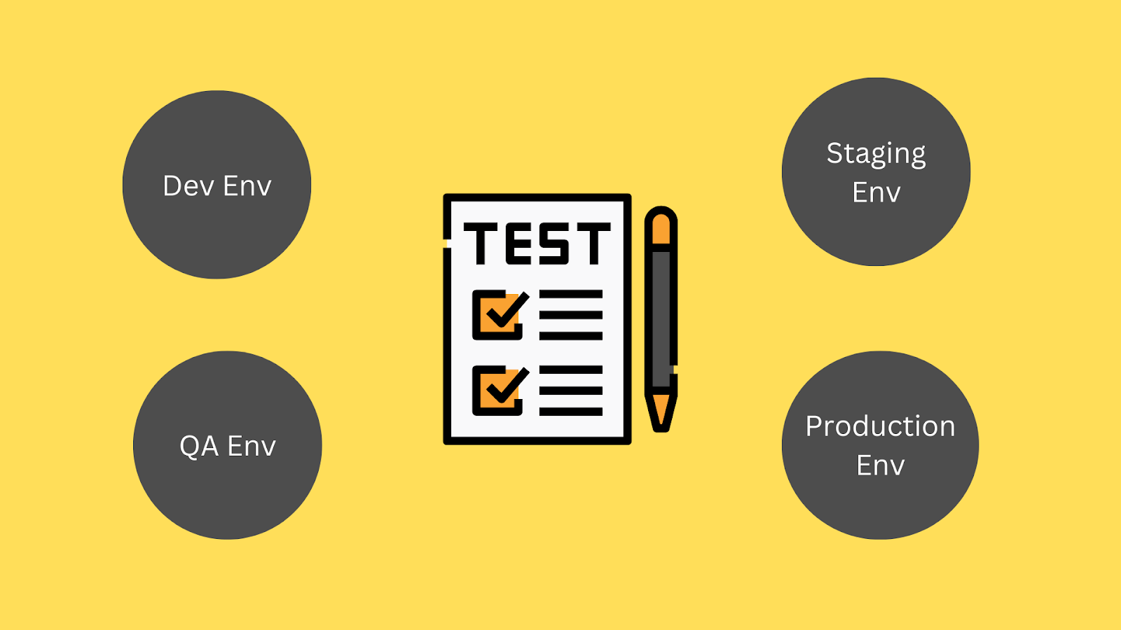
1. . What is Test Environment Management?
3. What are Test Environment Management Functions
2. Why is Test Environment Management Important
6. Challenges in Test Environment Management
?
6
5
5. Benefits of Test Environment Management
4. Activities Under TEM Functions
A Test environment is a dedicated setup or infrastructure where software testing activities such as smoke test, regression test, new feature test, and issue verifications for bug fixes would take place. It is an isolated and well-managed environment created to replicate the production environment or specific conditions required for testing. Test Environment Management is planning, setting up, maintaining, and controlling the test environments used for software testing. Ensuring accurate and trustworthy testing requires setting up and maintaining an appropriate environment such as a QA environment that closely resembles the production environment. By giving testers a reliable and constant environment, the main objective is to improve the efficiency of the testing process.
4
3
2
1

Slide 3
3. What are Test Environment Management Functions
6. Challenges in Test Environment Management
?
Diverse Application Needs: Each production application has unique demands. Some require just one test environment, while others might need a multitude. Think about it – the variety is vast, from single instances to hundreds. Effective environment management ensures your testing landscape matches the application’s complexity.
Tech Landscape Complexity: Modern IT architecture is a puzzle of distributed systems, intricate integrations, and shared environments. This complexity amplifies the challenges of project management and achieving business objectives.
Agile Release Demands: Agile development has pushed the boundaries of software release frequency. Daily, hourly, on-demand – the pace is relentless. Efficient test environment management aligns these rapid releases, preventing chaos.
Seamless Coordination: When numerous teams handle different aspects of the development lifecycle, coordination is vital. Test environment management bridges the gap, ensuring releases are well-orchestrated.
Conflict Resolution: Shared environments often confuse DevOps, QA, and Release Managers. A robust management strategy minimizes utilization clashes and keeps everyone on the same page.
Current Availability Information: Imagine knowing the exact availability status of a shared environment. Test environment management provides this clarity, streamlining resource allocation.
Optimized Resource Reuse: Reusing the same test environment can save time and resources. Proper management facilitates efficient recycling, maximizing your investment.
Version Tracking: Amidst the flurry of changes, tracking software package versions across environments becomes a puzzle. Test environment management offers the puzzle pieces, letting you know what’s where
6
5
5. Benefits of Test Environment Management
4. Activities Under TEM Functions
4
3
2
1

Slide 4
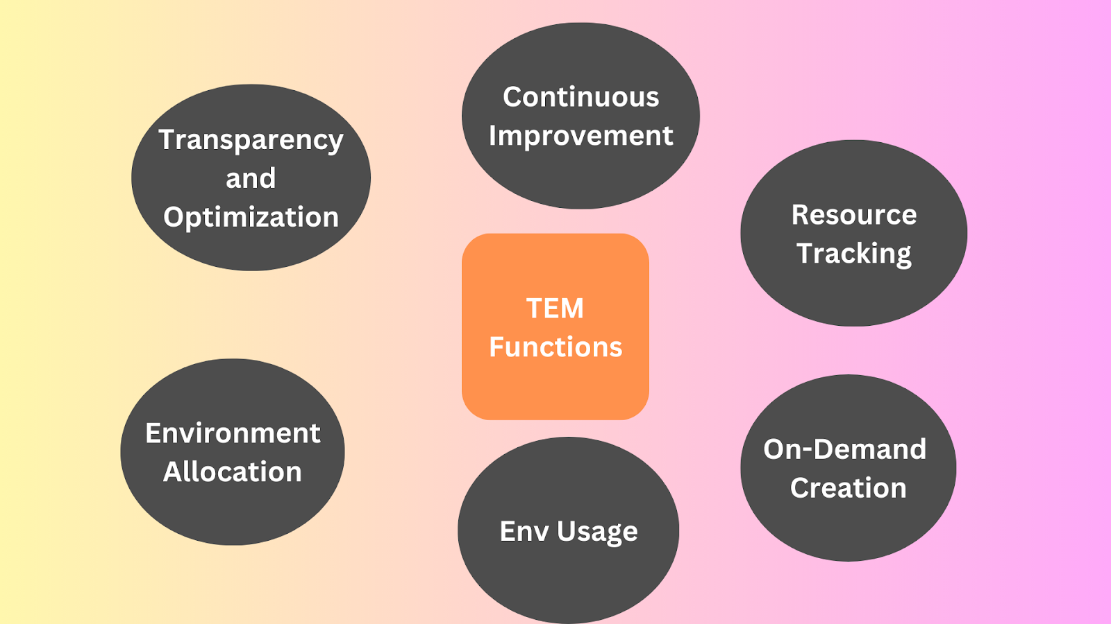
6. Challenges in Test Environment Management
?
6
5
Transparency and Optimization: Complete transparency of test environments allows for optimization and innovation.
Environment Allocation: Allocation of test environments across projects, teams, QA engineers, and tasks. This function involves effectively managing and assigning resources to ensure the availability of suitable environments for testing.
Resource Tracking and Management: Tracking resource usage, acquiring/releasing resources, and organizing shared access.
On-Demand Environment Creation and Maintenance: On-demand creation and maintenance of test environments to sustain resources.This function enables quick provisioning of environments. It includes necessary configurations and resources. It ensures the availability of required testing environments when needed.
Continuous Improvement and Automation: Continuous improvement, innovation, and automation to reduce manual tasks and optimize infrastructure costs.
Standardization of Environment Usage: Simplifying daily tasks and operations can help standardize environment usage. This function focuses on defining and implementing consistent processes, guidelines, and best practices for managing and utilizing test environments effectively.
5. Benefits of Test Environment Management
4. Activities Under TEM Functions
4
3
2
1

Slide 5
6. Challenges in Test Environment Management
?
Information Management: Maintain a central repository containing details of test environments, including their latest versions and connectivity information. This ensures everyone’s on the same page.
Demand Management: Allocate test environments based on teams’ requirements. Think of it as booking or scheduling resources for different testing needs.
Supply Management: When new testing environments are needed, create them promptly to match evolving demands.
Monitoring: Keep a watchful eye on the test environments. This helps detect anomalies, potential issues, or bottlenecks early on.
Housekeeping: Regularly update and clean up the repository by removing outdated or unnecessary test environments. This keeps the space organized and efficient.
Incident Management: If issues arise in the environment, handle preliminary investigations and coordinate with relevant teams until a resolution is reached.
Problem Management: Analyze data to identify patterns and trends in environment issues. Take proactive steps to address these issues and work towards long-term solutions.
Test Data Management: Ensure test data is accessible and available when testers need it. This could involve using a Test Data Management (TDM) tool or refreshing test data from other environments.
Continuous Improvement: Regularly evaluate the services provided in test environment management. Look for areas to enhance, whether through refining processes, tools, or the people involved.
Automation: Minimize manual tasks by introducing automation wherever possible. This boosts efficiency, reduces errors, and frees up valuable time.
6
5
5. Benefits of Test Environment Management
4
3
2
1

Slide 6
6. Challenges in Test Environment Management
?
Reproducibility and scalability
Ensures consistency and reproducibility, allowing organizations to scale their testing efforts efficiently. This means that test cases can be executed repeatedly in the same environment, producing consistent results.
By maintaining the integrity of the test environment, TEM enables testers to identify and reproduce defects accurately.
As the scope and complexity of testing increase, organizations may need to expand their testing infrastructure to handle larger workloads and test scenarios. With TEM, it becomes easier to provision additional resources, such as hardware and software, to support the growing testing requirements.
Risk Mitigation
It helps reduce risks associated with software development and testing.
Enhanced Collaboration
Improves communication, reduces conflicts, and enhances productivity
Efficient Resource Utilization
Reduces costs by providing resources on demand.
Faster Time-to-Market
Organizations can speed up software delivery by streamlining the provisioning and configuration of test environments.
Improved Quality
Improves software quality by providing reliable and consistent environments and helps to identify issues early in the development lifecycle, leading to better-quality software.
6
5
4
3
2
1

Slide 7
6. Challenges in Test Environment Management
?
Software testing environment management is essential for ensuring the quality and effectiveness of the testing process, but it also presents various challenges.
Resource Allocation
It can be difficult to allocate and manage resources like hardware, software licenses, and testing tools, especially when several projects or teams need to use them.
Environment Replication
Due to variations in infrastructure, configurations, and data, it can be challenging to ensure that test environments precisely replicate the production environment since this can produce inconsistent testing results.
Configuration Management
It can be difficult and time-consuming to manage the configurations of different test environment components, which frequently leads to configuration drift and compatibility problems.
Environment Dependencies
Coordinating and managing the relationships between the additional components like external systems, APIs, or third-party services can take time, which could hinder test execution.
Data Management
It can be difficult to manage test data effectively, including maintaining data privacy, assuring data integrity, and producing realistic test datasets, particularly if dealing with sensitive or huge amounts of data.
6
5
4
3
2
1

